Slide 1
Azure Machine Learning
Manjunath S

Slide 2



Transform data into intelligent action
Information Management
Big Data Stores
Machine Learning and Analytics
Intelligence
Data Sources
People
Data Factory
Data Lake Store
Machine Learning
Cognitive Services
Data Catalog
SQL Data
Warehouse
Data Lake Analytics
Bot Service
Web
Apps
HDInsight
(Hadoop and Spark)
Event Hubs
{ }
CosmosDB
Cortana
Mobile
Apps
Stream Analytics
Dashboards & Visualizations
Bots
Sensors and devices
Azure Analysis Services
Power BI
Automated Systems
Data
Intelligence
Action
Notes:
T: Cortana Intelligence provides everything you need to transform your organization’s data into intelligent action. Next, let’s take a look at another demo.

Slide 3
Infinite world of scalable machine learning
Traditional algorithms
logistic regression, linear models, basic statistics, hypothesis testing, k-means, decision trees
Specialized algorithms
page rank, collaborative filtering, graph processing, SVD, PCA, Bayesian models, …
Deep learning algorithms
deep learning over various types of networks

Slide 4
Use cases of scalable machine learning
Retail | Financial services | Healthcare | Manufacturing
loyalty programs customer acquisition pricing strategy supply chain mgnt | customer churn fraud detection risk & compliance cross-sell & upsell personalization | bill collection operational efficiency patient demographics pay for performance | demand forecasting pricing strategy supply chain optimization predictive maintenance remote monitoring
Traditional algorithms
Specialized algorithms
product recommendations
intelligent search
routing
robotics
ad placement
predictive maintenance
Deep learning algorithms
image, video recognition
sentiment analysis
text comprehension
natural language processing
robotics
bots
augmented reality
predictive maintenance

Slide 5
Data Science Process
Historical Data
[features + labels]
Future Data
[features only]
Define Objective
Split
Training Data
[features + labels]
Testing Data
[features + labels]
Access and Understand the data
Train Model
[model learns from training data]
Score Model
[model predicts on future data]
*
Score Model
[model predicts on testing data]
Pre-processing
Prediction Results
Evaluate Model
[Compare predicted results and true labels]

Slide 6
Machine Learning & AI Portfolio When to use what?
Microsoft ML & AI products
Build your own or consume pre-trained models?
Build your own
Consume
Azure Machine Learning
Cognitive services, bots
Which experience do you want?
Code first
Visual tooling
Deployment target
(On-prem) ML Server
(cloud)
AML services (Preview)
(cloud)
AML Studio
What engine(s) do you want to use?
On-prem Hadoop
SQL Server
SQL Server
Spark
Hadoop
Azure Batch
DSVM
Azure Container Service
Notes:
We have a lot of AI capabilities

Slide 7
Azure Machine Learning Studio

Slide 8
Azure Machine Learning Service Data -> Predictive model -> Operational web API in minutes
Data
Clients
API
ML STUDIO
Model is now a web service that is callable
Blobs and Tables
Hadoop (HDInsight)
Relational DB (Azure SQL DB)
Integrated development environment for Machine Learning
Monetize the API through our marketplace
Notes:
So let’s take a look at the technology itself. The elegance of the solution is in its simplicity – something that has been lacking in the machine learning space which is a key reason this space has not improved in generations. But we are here to change this.
The first issue many enterprises face is data ingestion. With the cloud, you can bring in data sources with the ease of a drop down or drop your on-premises data set into the built in storage space. Users can then model in our development environment – Machine Learning Studio – where we’re offering R, Python and SQLite as first class citizens in addition to our world-class Microsoft algorithms.
The second issue – and often the primary one – is putting finished work into production in a way others can use. We’ve heard from many data scientists that they model in R on a Linux stack but then have to hand over their work to developers who need to translate that into another language to actually make it work. This time consuming and unnecessary process has been eliminated with our system, as the model is with a click transformed into a web service end-point that can run over any data, anywhere and connect to any solution or client.
Next, not only can this model be put into production for your company, it can be made available for the world on our Machine Learning Marketplace. Microsoft hosts your solution and markets it for you, while you have the freedom to brand and monetize as you see fit. We also offer a number of Microsoft solutions here.

Slide 9
Azure Machine Learning
Fully managed cloud service
Visual and collaborative tools
Library of starting templates for common tasks
One click operationalization through web services
Ready-to-consume web services in Marketplace, such as Recommendations, Anomaly Detection.
Publish, Share, Monetize your models
Notes:
Objective: Introduce Azure Machine Learning and discuss the setup and advantages.
Talking Points:
<<animation>>
Why Azure Machine Learning?
Azure Machine Learning is a fully managed cloud service that enables you to easily build, deploy, and share predictive analytics solutions. It provides visual and collaborative tools to create predictive models that can be published as ready-to-consume web services, without worrying about the hardware or the VMs that perform the calculations.
With only a browser, you can sign in, upload data, and immediately start machine learning experiments. Drag-and-drop predictive modeling, a large pallet of modules, and a library of starting templates make common machine learning tasks simple and quick.
To get started is very easy:
You first need to create an Azure subscription. You can sign up for a one-month free trial Azure subscription and upgrade it later to a full subscription.
Next, create an Azure storage account to access Azure Blob, Queue, Table, and File services.
After creating the storage account, set up a Machine Learning workspace in just a few steps. For this we just need to go to the Azure portal and click New on the bottom left of the screen. Select Data Services, choose Machine Learning, and within a few clicks the Azure Machine Learning workspace is created.
Alternatively, you can go to the ML Studio website directly by typing http://studio.azureml.net in the IE address bar, and then entering the email address and password associated with your Azure subscription.
Advantages
Advantages include a simplified environment, a unified experimentation location, and a publishing feature for the API.
Azure Machine Learning has everything you need to create predictive analytics solutions in the cloud, from a large algorithm library, to a studio for building models, to an easy way to deploy your model as a web service.
Create predictive models in Machine Learning Studio, a browser-based tool, by dragging, dropping, and connecting modules.
Use a large library of Machine Learning algorithms and modules in Machine Learning Studio to jump-start your predictive models. Choose from a library of sample experiments, R and Python packages, and best-in-class algorithms from Microsoft businesses like Xbox and Bing. Extend Studio modules with your own custom R and Python scripts.
Purchase ready-to-consume web services from Microsoft Azure Marketplace, such as Recommendations, Text Analytics, and Anomaly Detection.
You can also operationalize your predictive analytics models.

Slide 10
Components of Azure ML – Studio
https://studio.azureml.com
Browser Base Modelling tool, Drag and drop interface
Build, Test and Deploy workflow
Modules – ports and connectors.
Use custom R and Python scripts – not spread across nodes. Runs on single node.
Jupyter Notebooks
Built-in support for statistical functions, data ingest, transform, feature generate/select, train, score, evaluate for tabular data and text across classification, clustering, recommendation, anomaly.
Data Sources - Azure SQL DB, Azure SQL DWH, Blob Storage, DocumentDB, Hive Tables,On Premise SQL Server (preview), Web URL, Azure Tables

Slide 11
Components on Azure ML – APIs
Operationalize the model for production use
Request Response API – low latency
Batch Execution API – asynchronous service
Retraining possible programmatically
You can also create web services directly by using Jupyter Notebooks and RStudio through AzureML Package

Slide 12
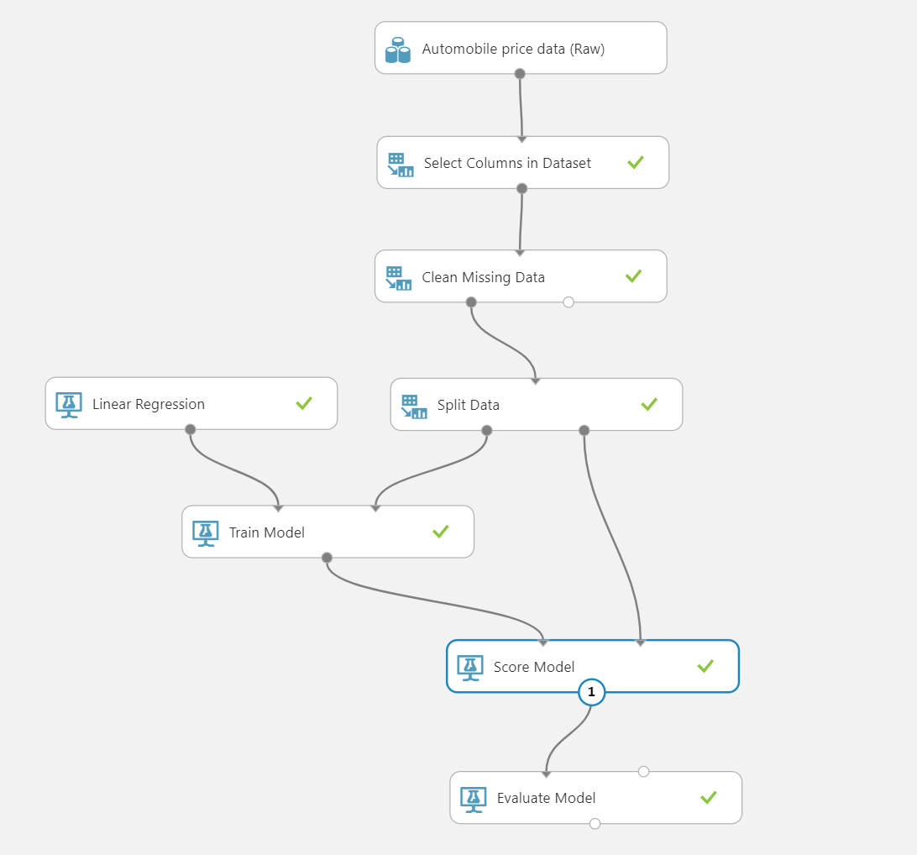
Demo

Slide 13
Spark on HDInsight

Slide 14
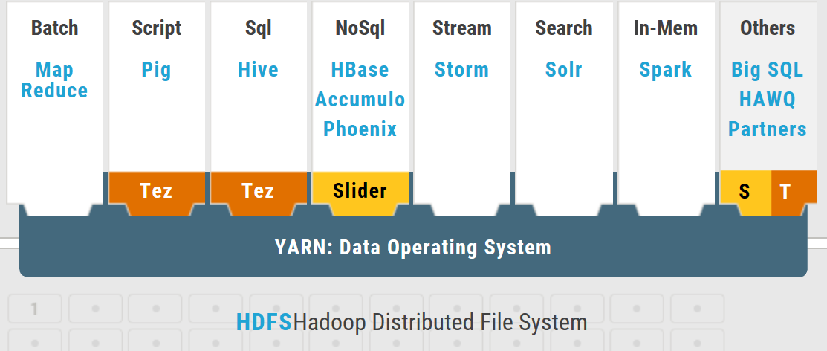

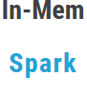
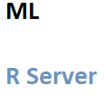

Hadoop Architecture (HDInsight)
Sqoop
Kafka
WebHDFS
Zeppelin
Jupyter
OOZIE
Azure Portal, Powershell, CLI and Azure SDK
Ambari (Hortonworks)
Zookeeper
Data Flow
Tools
Scheduling
Operations (Provisioning, Managing and Monitoring
Data Access
Other Services through Action Script
Apache Ranger
Shared Access Signatures
Encryption at both Transit and at Rest
Security
Azure HDInsight
Storage – Azure Data Lake Store or Azure Blob Storage

Slide 15
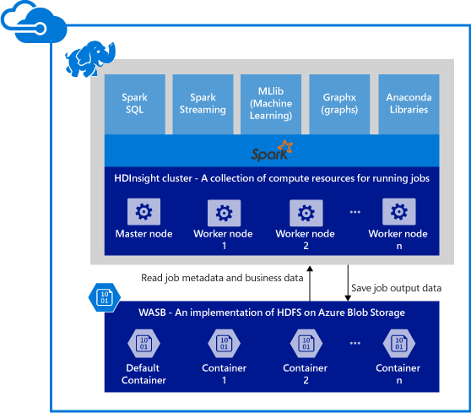
Spark/HDInsight
Apache Hadoop in the cloud
Built on Hortonworks Data Platform (HDP)
Hadoop with Enterprise security and manageability
Deployment agility
Insights through Excel
Develop in .NET and Java
Powered by the cloud
Get started in minutes
Integrated with Azure ML, PowerBI & ADF
Spark for Azure HDInsight
Single execution model for multiple tasks (SQL queries, Streaming, Machine Learning, and Graph)
Processing up to 100x faster performance
Developer friendly (Java, Python, Scala)
BI tool of choice (Power BI, Tabelau, Qlik, SAP)
Notebook experience (Jupyter/iPython, Zeppelin)
99.9% SLA
Spark MLLib for Machine Learning (Open source)
R Server for Spark/HDInsight (Commercial)
R Server

Slide 16

Experiment Everywhere
Local machine
Scale up to DSVM
Command line tools
Scale out with Spark on HDInsight
IDEs
Notebooks in Workbench
AZURE ML
EXPERIMENTATION
VS Code Tools for AI
Azure Batch AI (Coming Soon)
ML Server
Notes:
Start with the set of tools you want to use: command line, editors, notebooks, VS Tools for AI
Connect to Experimentation service, connects to various compute contexts
Docker container based deployment allows:
Single node deployment (cloud/on prem)
Clustered deployments via Azure Container Service
public preview target of 10k RPS on ACS cluster configuration
Currently have published models (via TLC) with <10ms latency
Edge deployment via Azure IOT Edge
Microsoft ML Server on-premises
Other deployment options
Spark clusters
Data engines:
SQL
CosmosDB (roadmap)
U-SQL (roadmap)
FPGAs (roadmap)
Serverless (roadmap)
Docker logo
Single node (on prem, cloud
ACS
Edge
MSFT ML Services
Spark cluster
SQL
Use slide 8 as reference
List

Slide 17

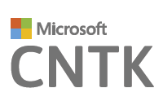
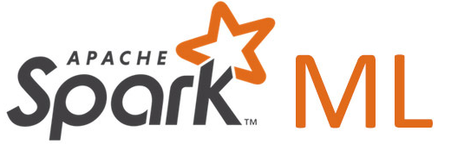
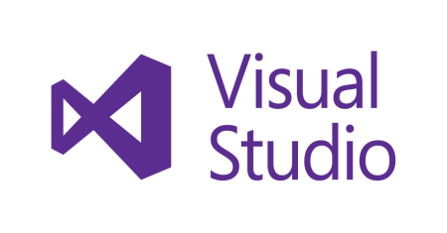

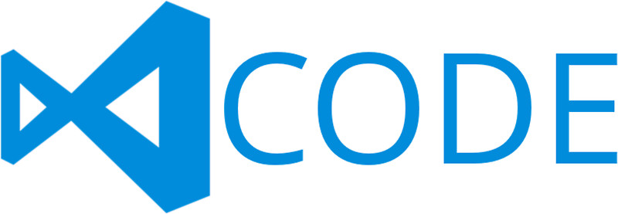





Experimentation service
Manage project dependencies
Manage training jobs locally, scaled-up or scaled-out
Git based checkpointing and version control
Service side capture of run metrics, output logs and models
Use your favorite IDE, and any framework
Use any framework or library
Use any tool
Use the most popular innovations
Notes:
Behind any project you create is a Git repository. Can share projects.
DS is not as linear as software development. You don’t go back to run history as a dev.
DS look back to all runs as to which one had best performance.
Any data, any framework. Tensorflow logo, CNTK logo, Spark logo
See inset for Tensorflow logo

Slide 18
Deploy Everywhere
Single node deployment (cloud/on-prem)
Azure Container Service
Azure IoT Edge
AZURE ML
MODEL MANAGEMENT
DOCKER
Microsoft ML Server
Spark clusters
SQL Server
Notes:
Take what built and wrap it up in a Docker container. Feed back metrics of model and give tools to manage model.
Meets diverse needs: Maybe 10,000 models deployed that are called infrequently, or 1 model replicated on 1,000 cores because everything uses that model
You get control on where and how want to deploy model
Docker container based deployment allows:
Single node deployment (cloud/on prem)
Clustered deployments via Azure Container Service
public preview target of 10k RPS on ACS cluster configuration
Currently have published models (via TLC) with <10ms latency
Edge deployment via Azure IOT Edge
Microsoft ML Server on-premises
Other deployment options
Spark clusters
Data engines:
SQL
CosmosDB (roadmap)
U-SQL (roadmap)
FPGAs (roadmap)
Serverless (roadmap)
Docker logo
Single node (on prem, cloud
ACS
Edge
MSFT ML Services
Spark cluster
SQL
Use slide 8 as reference
List

Slide 19
SQL Server 2017 ML Services – R & Python

Slide 20
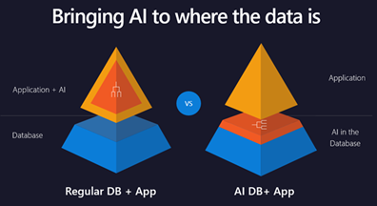
SQL Server 2017

Slide 21




Traditional Use of R
Databases
Open Source R:
R Scripts
CRAN Packages
Data Connectors
Data
EDWs

Slide 22
Achieving Even Greater Scale: Remote Execution
Open Source R Provides:
R Scripts
CRAN Packages
EDWs
Revolution R Enterprise Adds:
Scalable Parallel Algorithms
Easier Development
Improved Memory Utilization
Web Services Deployment
High Quality R Development Tools
Remote Execution in Hadoop, Grids, EDWs.
Data Connectors
Remote Execution Contexts
Data
Work

Slide 23
In-database Advanced Analytics at Scale
Benefits
Faster deployment of ML models
Less data movement, faster insights
Work with large datasets: mitigate R memory and scalability limitations
How is it Integrated?
T-SQL calls a Stored Procedure
Script is run in SQL either in Memory or InDB
Result sets sent through Web API
Example Solutions
Fraud detection
Sales forecasting
Warehouse efficiency
Predictive maintenance
Extensibility
R Integration
R
?
Analytic Library
Open Source R
Revolution PEMA
Data Scientist
Interact directly with data
010010
100100
010101
T-SQL Interface
Relational Data
Data Developer/DBA
Manage data and
analytics together
SQL Server

Slide 24
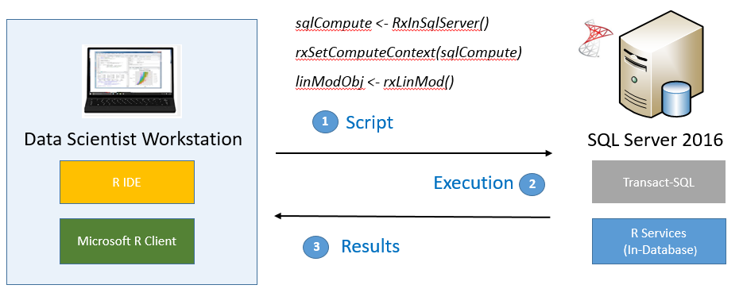
Remote Execution inside SQL Server
Working from your R IDE/Python IDE/Visual Studio on workstation, you can execute an R/Python script that runs in-database, and get the results back.

Slide 25
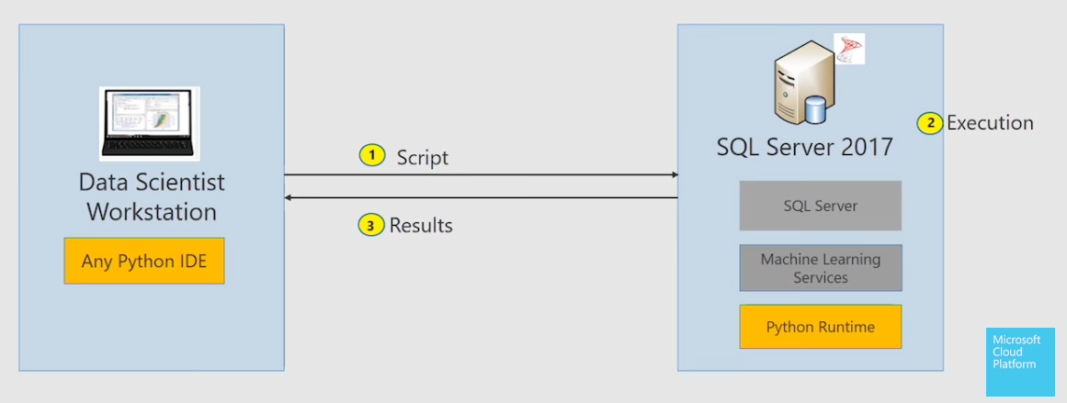
Remote Execution inside SQL Server - Python

Slide 26
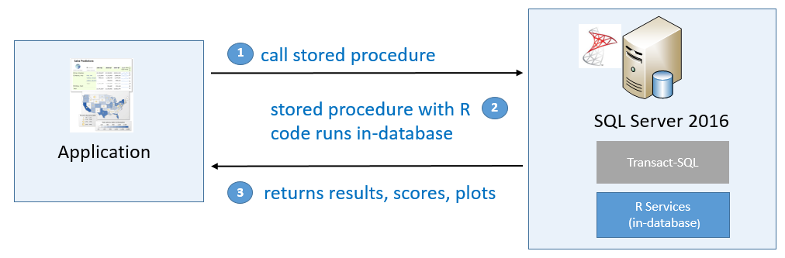
Operationalize using T SQL / Stored Procs
The stored procedure contains R code and executes in-database.
exec sp_execute_external_script
@ languague = ‘R’/’Python’
, @script =
-- R code --

Slide 27
Why In-Database Analytics with SQL 2017?
Bring compute to data
with In-Database analytics
SQL Server 2017 extensibility mechanism allows secure execution
of R/Python scripts on the SQL Server
Use familiar T-SQL stored procedures
to invoke R/Pythin scripts from your application.
Embed the returned predictions and plots in your application.
Operationalize R/Python scripts and models
Use SQL Server’s in-memory querying and Columnstore Indexes Leverage RevoScaleR and RevoScalePy support for large datasets and parallel algorithms with SQL Server 2017 Enterprise Edition.
Enterprise Performance and scale

Slide 28
Other Features
Support for Open source R Packages
Support for Scikit Learn ML packages
Trained Neural Network Models for Image Featurization to bring deep learning to SQL Server
Text and Sentiment Analysis Models

Slide 29

Microsoft Cognitive Services preview
Vision
Computer Vision | Emotion | Face | Video | Content Moderator
Cognitive Services
Give your solutions a human side
Speech
Custom Recognition | Speaker Recognition | Speech
Language
Bing Spell Check | Language Understanding | Linguistic Analysis | Text Analytics | Web Language Model | Translator Text and Speech
Knowledge
Academic Knowledge | Entity Linking | QnA Maker Knowledge Exploration | Recommendations
Search
Bing Auto Suggest | Bing Image Search | Bing News Search | Bing Video Search | Bing Web Search
Notes:
At Microsoft, we’ve been offering APIs for a very long time across the company. In delivering Microsoft Cognitive Services API, we started with 4 last year at /build (2015); added 7 more last December, and today we have 25 APIs in our collection.
Cognitive Services are available individually or as a part of the Cortana Intelligence Suite, formerly known as Cortana Analytics, which provides a comprehensive collection of services powered by cutting-edge research into machine learning, perception, analytics and social bots.
These APIs are powered by Microsoft Azure.
Developers and businesses can use this suite of services and tools to create apps that learn about our world and interact with people and customers in personalized, intelligent ways.

Slide 30
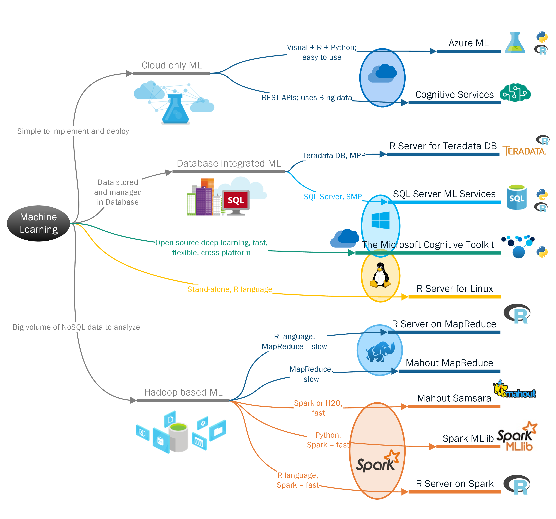
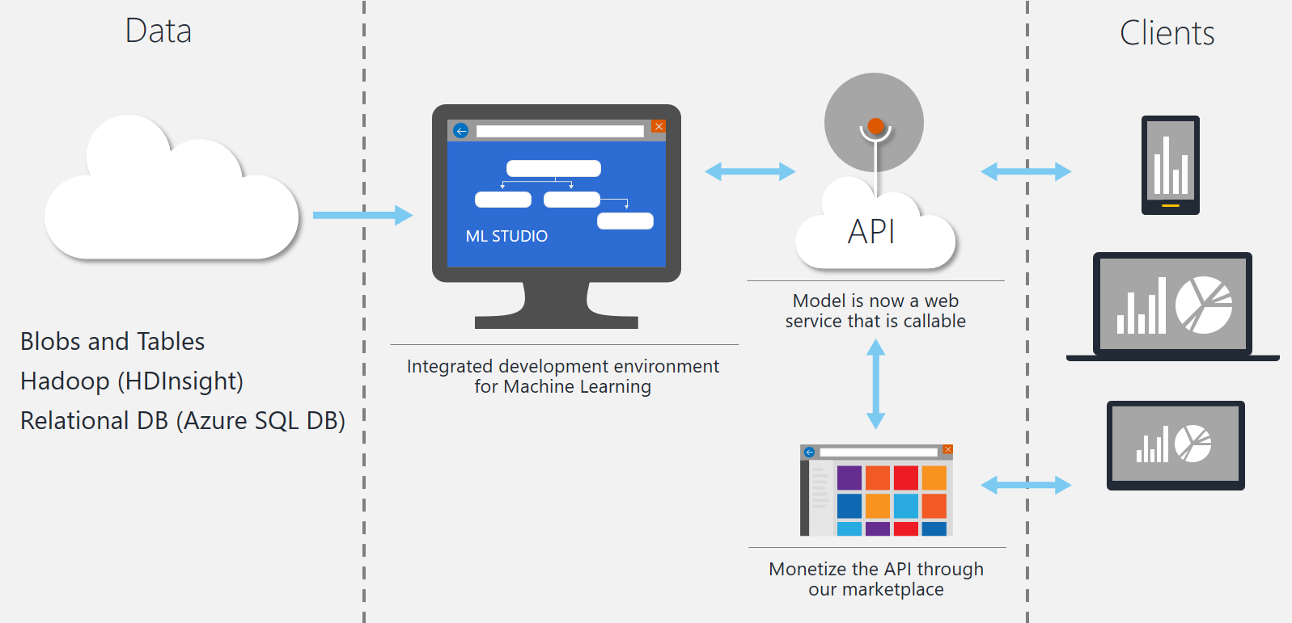

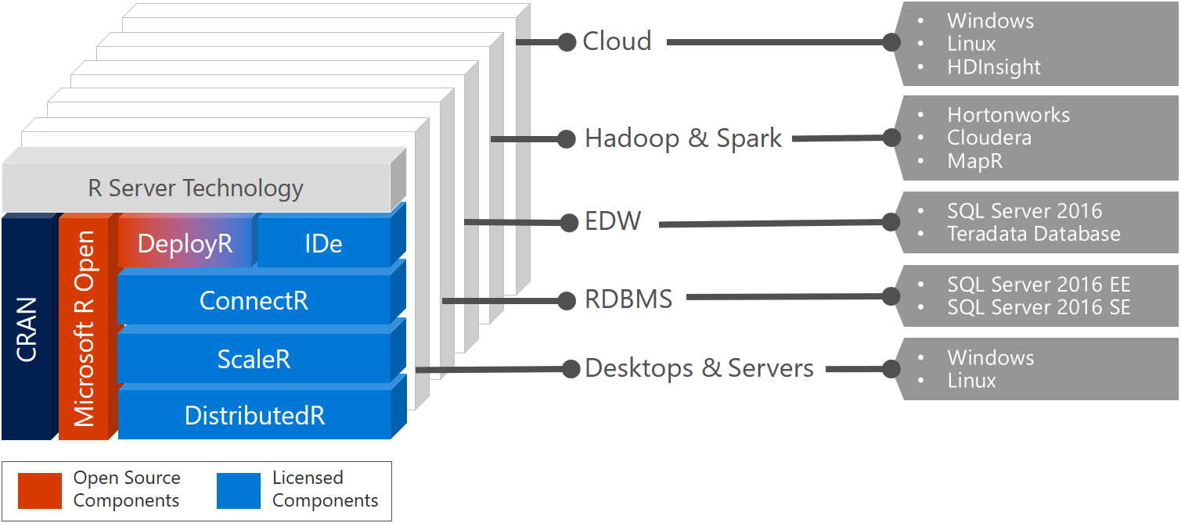
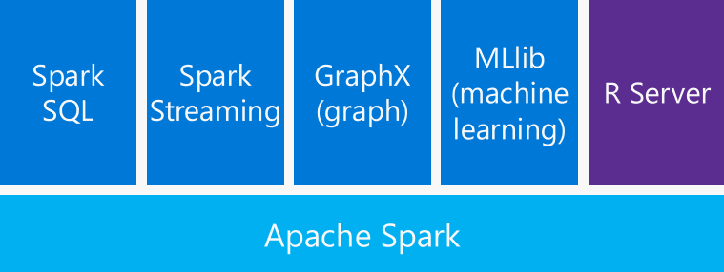
Machine Learning Decision Tree
Source: https://biz-excellence.com/2016/09/13/machine-learning-dt

